Slide 1
The Emergence of Symbolic Cognition from Sensory-Motor Dynamics
Randall C. O’Reilly
University of Colorado Boulder
eCortex, Inc

Slide 2
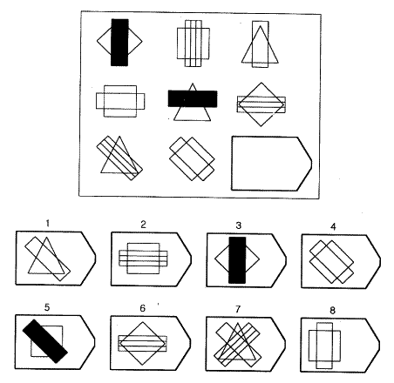
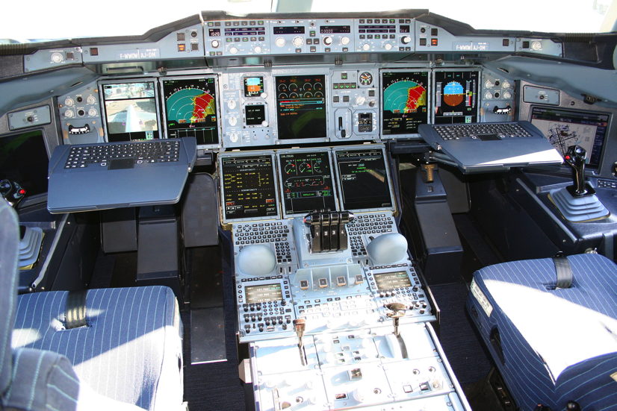
Cognitively: What is Vision For?
Vision is active, goal-driven, requires iterative, flexible parsing of complex visual scenes
Raven’s progressive matricies: test of general intelligence – depends on dynamic vision

Slide 3
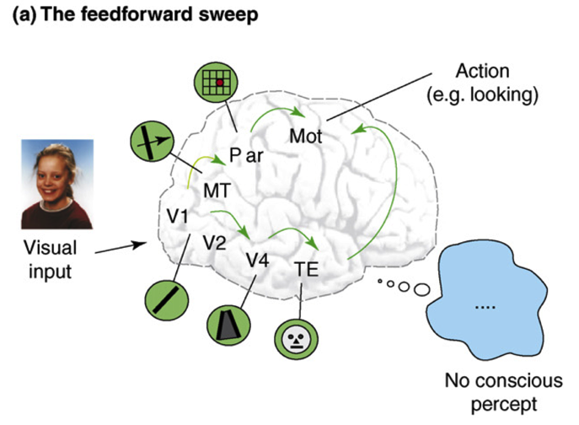
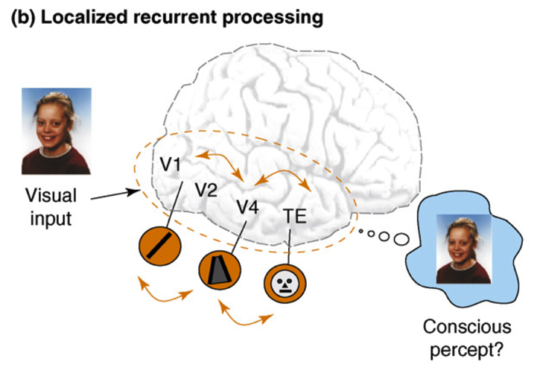
Recurrent Processing -> Consciousness (Lamme, 2006)
Consciousness is Unitary
Recurrence coordinates all areas on one thing (emerges via popular vote)
Consciousness is Functional
Helps organize, prioritize behavior – “focusing” key for difficult problems
Consciousness Flows
Temporal dynamics and information processing (multi-step cognition)

Slide 4
Attention and Consciousness
Recurrent dynamics / consciousness supports goal-driven top-down interaction with bottom-up visual processing.
Goal: Capture this process in a computational model, based on biological details of the cortex (and thalamus) to better understand exactly what is going on..

Slide 5
Bidirectional Constraint Satisfaction Word Superiority Effect: McClelland & Rumelhart, 1981

Slide 6
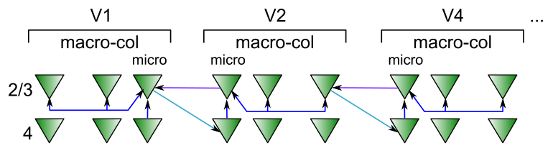
Superficial Attractor / Constraint Satisfaction Network
Computationally captured by Hopfield / (Deterministic) Boltzmann Machine models..
Except that cortical pyramidal neurons are only excitatory – need inhibitory interneurons

Slide 7
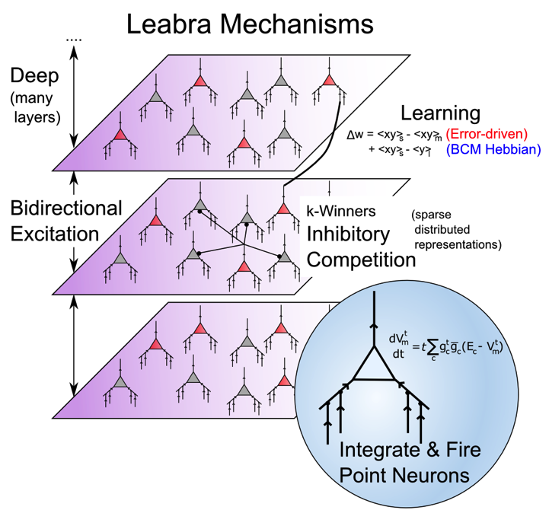
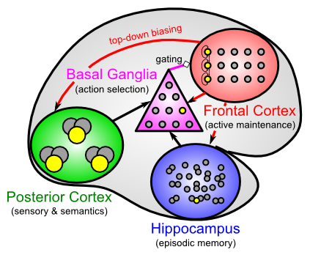
Leabra Biologically-based Cognitive Architecture
Same framework accounts for wide range of cognitive neuroscience phenomena: perception, attention, motor control and action selection, learning & memory, language, executive function – all built out of the same neurons.
http://ccnbook.colorado.edu

Slide 8
Two Parallel Networks: Thalamus & Cortex

Slide 9
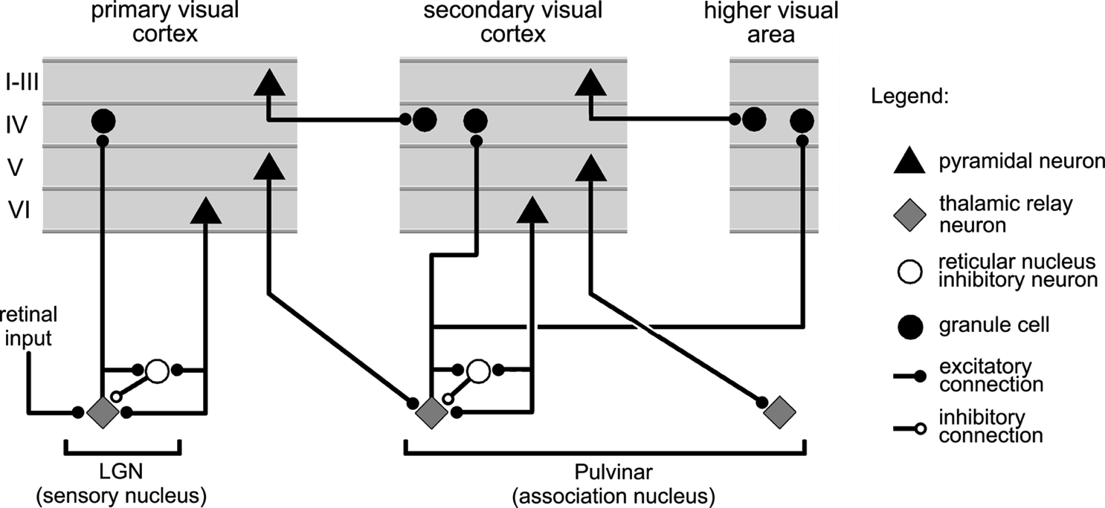
Thalamocortical Loop Biology (Sherman & Guillery, 2006)
Deep Layers drive thalamus, have strong top-down feedback effects.

Slide 10
Thalamocortical Mysteries
Why does higher-order thalamus have a few strong driver inputs, and far more weaker ones?
Why are these drivers non-plastic? How can cortex learn if thalamus does not?
What is function of the alpha rhythm (10Hz), which predominates in deep layers and thalamus?

Slide 11
Two Functions of Deep/Thal Circuit
Attentional dynamics
Deep layers particularly important for top-down
Multiplicative, normalization dynamics
Predictive learning
Context from t-1 to predict at time t (SRN)
Time updates every 100 msec (10 Hz, alpha)
Thalamic relay cells (TRC) are substrate for local auto-encoder learning

Slide 12
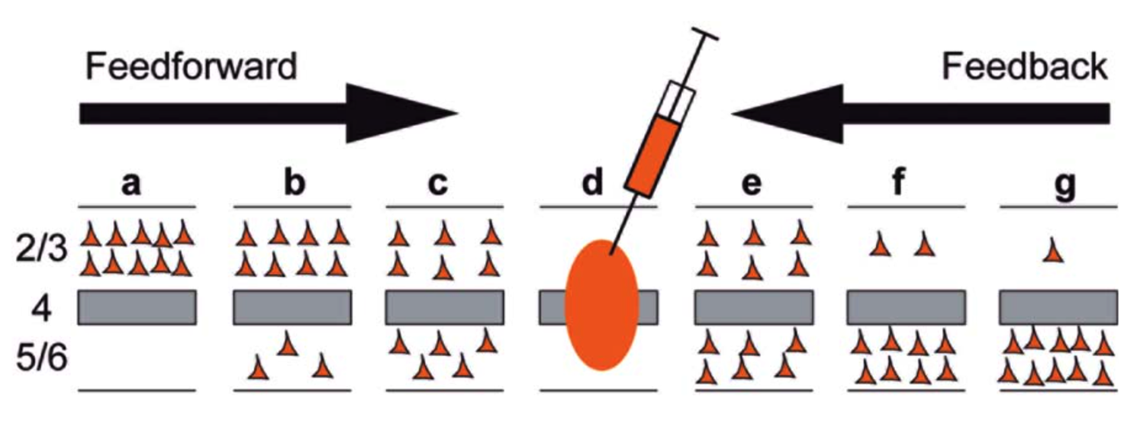
Deep Dominates Feedback
Markov et al, 2014
Feedback projections, especially those further up the hierarchy, are predominantly from deep layers – deep is particularly important for top-down attentional processing..

Slide 13
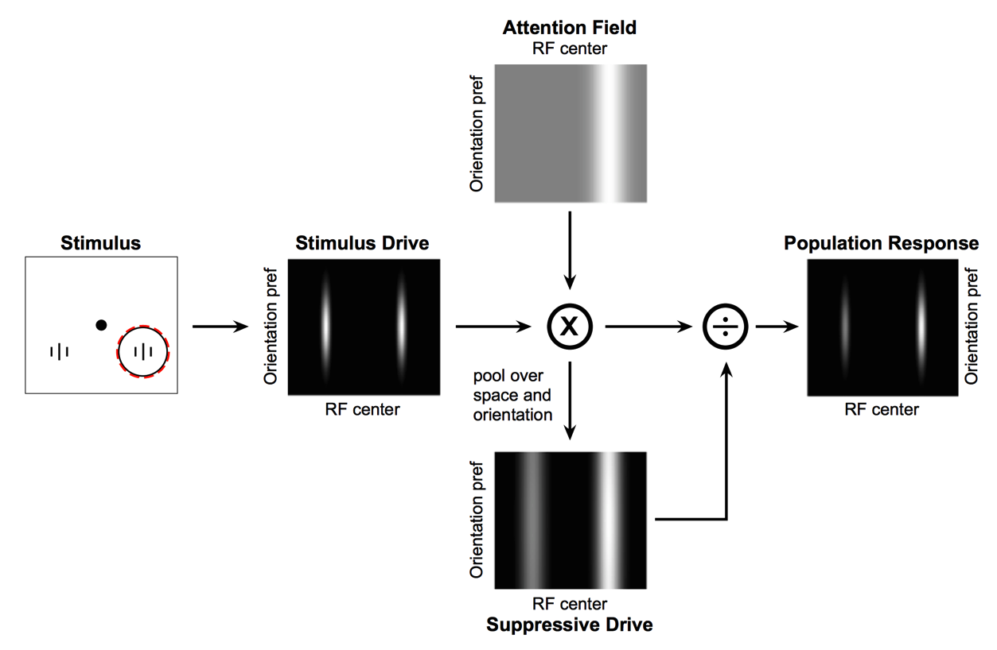
Deep Attentional Dynamics (Reynolds & Heeger, 2009; Grossberg, 1999)
Top-down deep layer
Attentional drive
Inputs to Layer 4
Layer 6 gain control
(Olsen, Bortone et al)

Slide 14
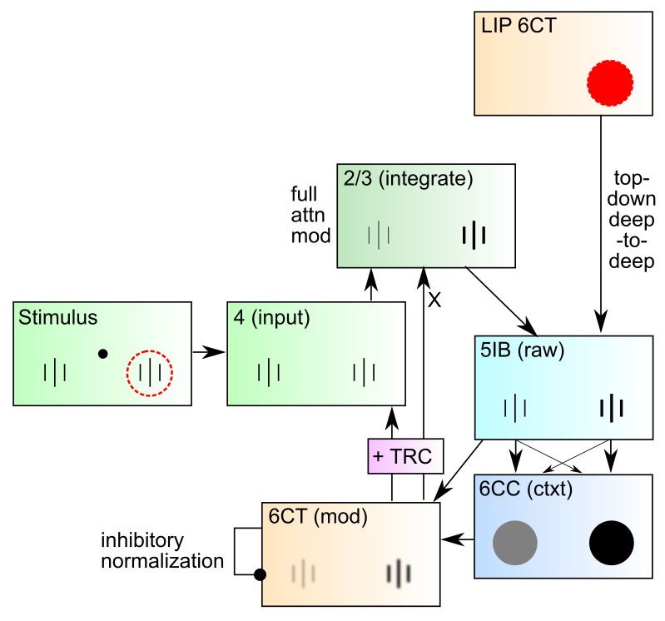
DeepLeabra Attentional Dynamics

Slide 15
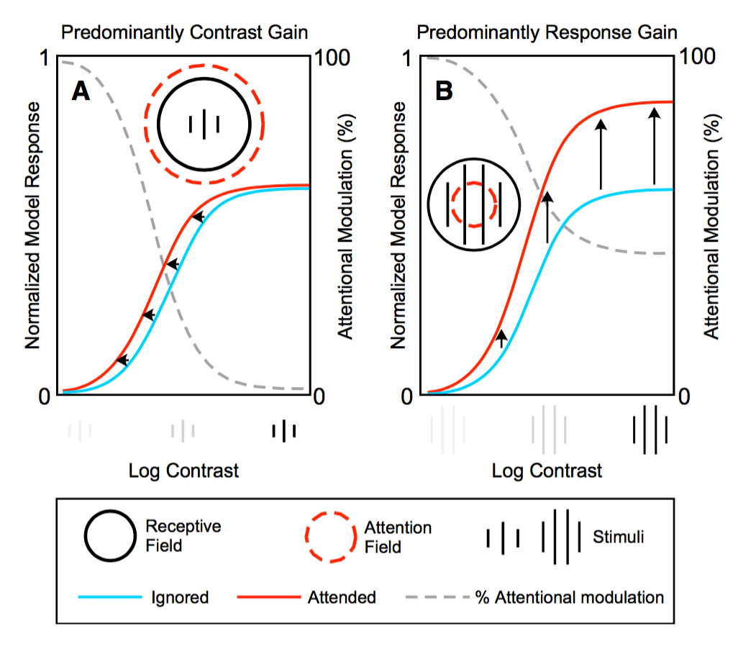
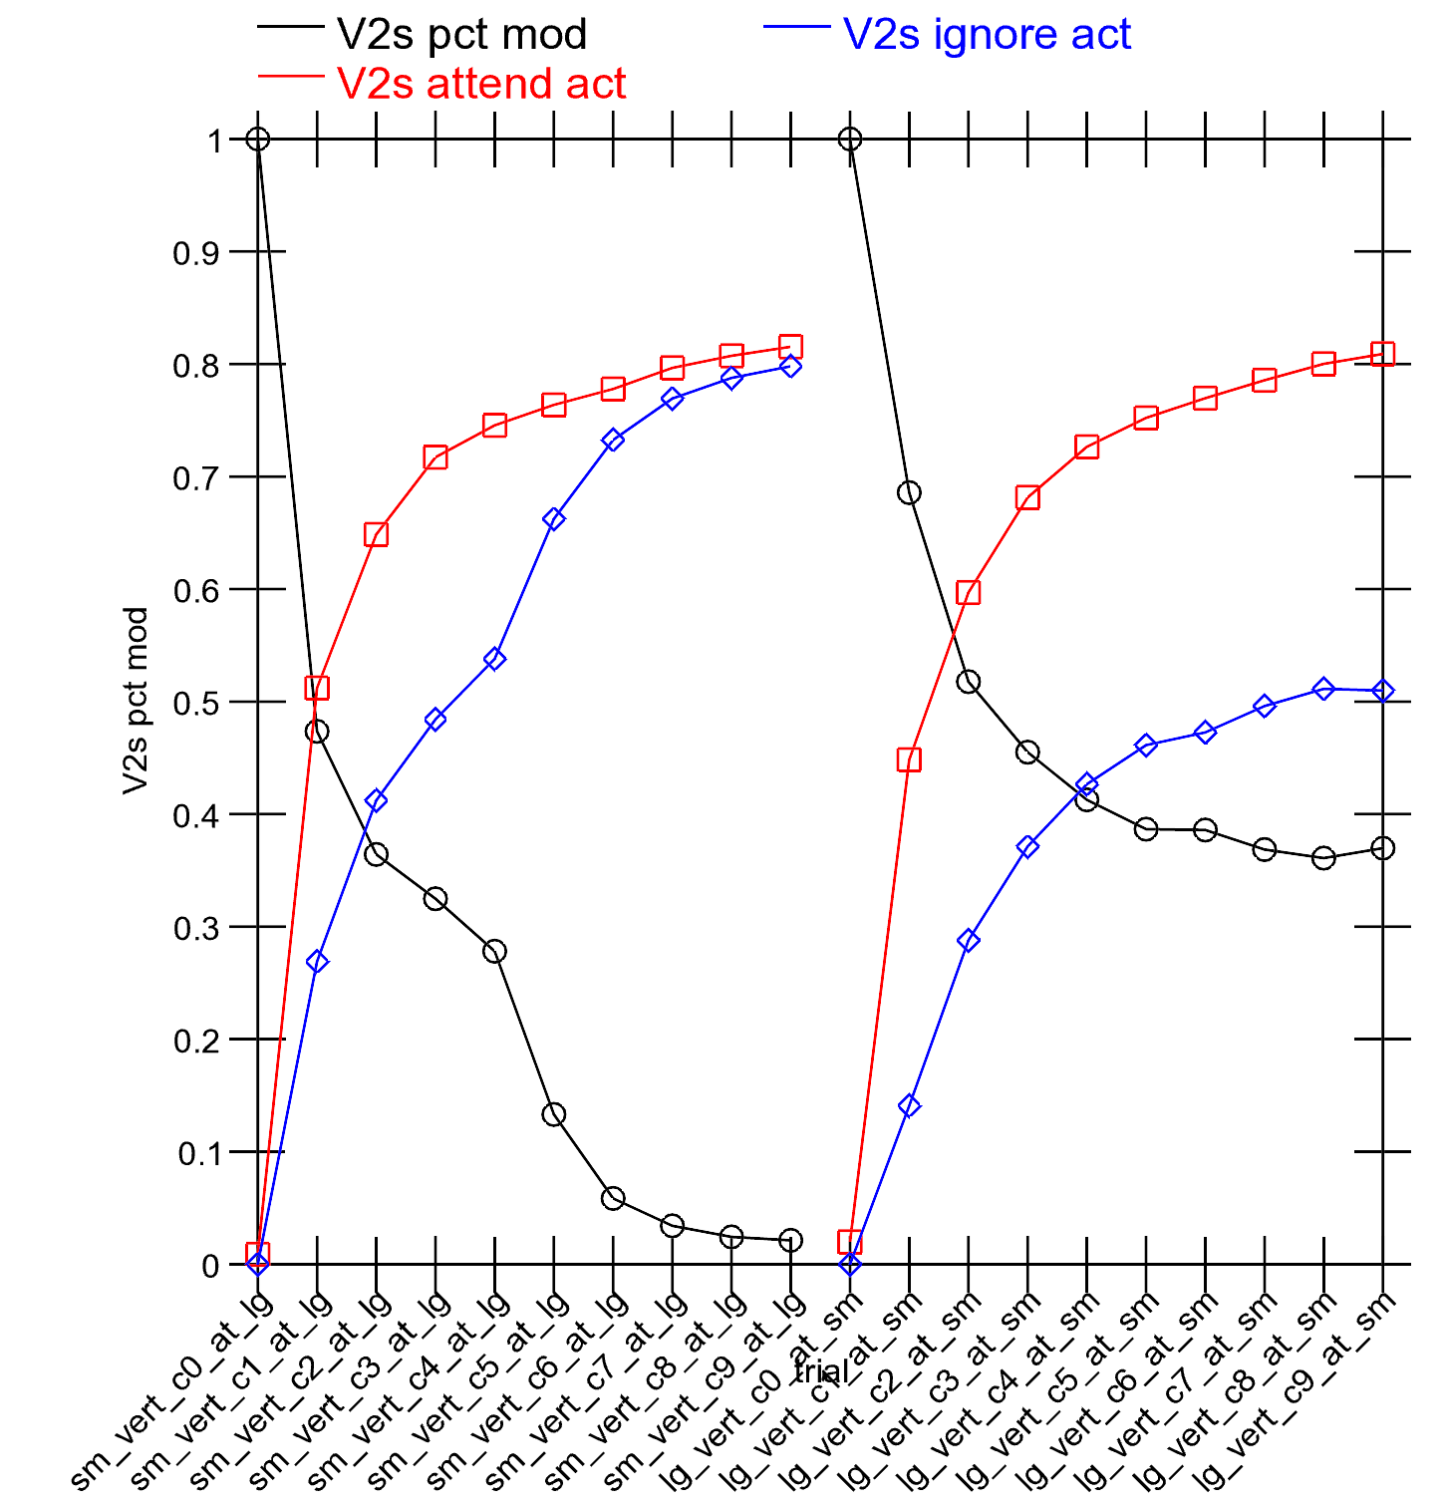
Attentional Dynamics Results

Slide 16
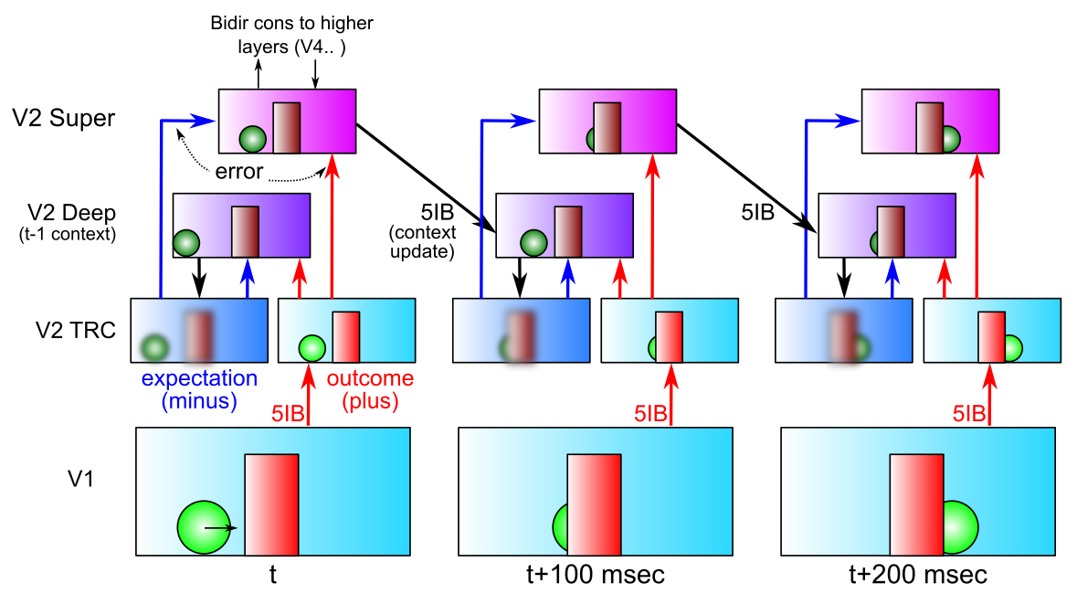
DeepLeabra Predictive Learning
Predictive learning creates nearly infinite supply of challenging learning problems: can learn a lot about physics and visual structure
Widely exploited idea: Helmholtz, Elman, Hawkins…
Requires encoding of prior context for future prediction (SRN)

Slide 17
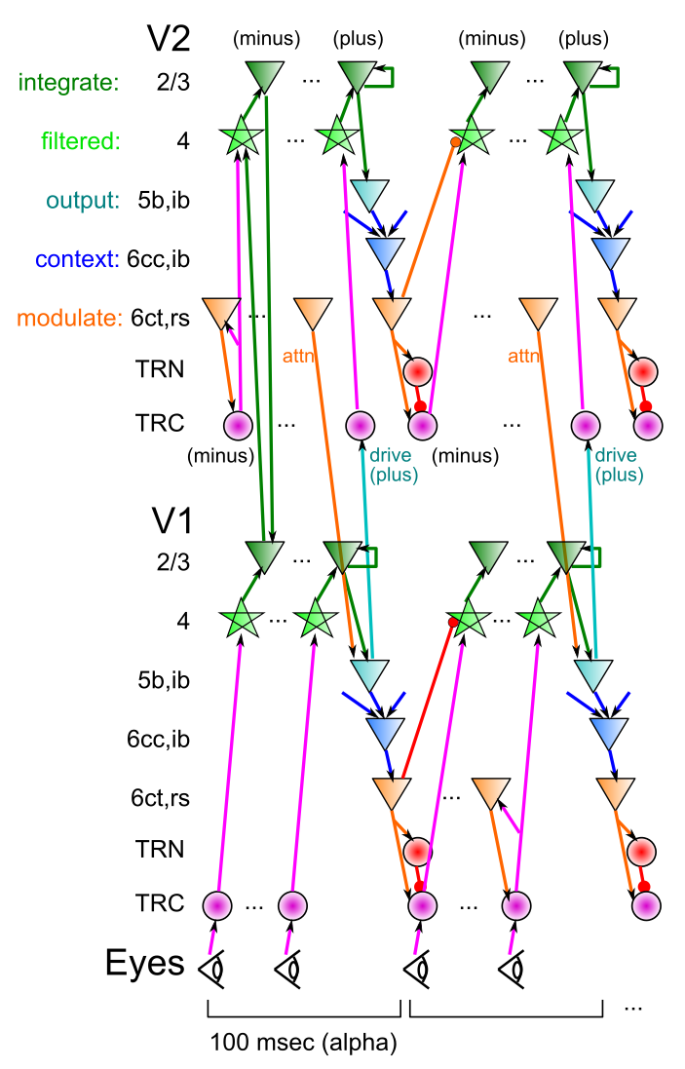
DeepLeabra
Deep neocortical layers drive multiplicative attentional modulation, through direct and thalamically mediated connections.
Alpha cycle (100msec) provides frame rate for updating of attentional mask, determined by 5ib bursting
EM-like dynamics where superficial network settles within fixed attentional mask, then attn mask is updated..
5ib also drives feedforward TRC prjn: plus phase clamp of TRC-based autoencoder (local learning signals)
6cc context provides SRN-like temporal context information for predictive learning

Slide 18
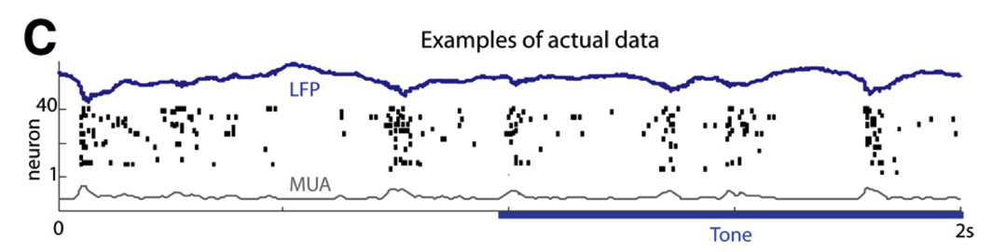
Deep Alpha: Key Biological Data
Alpha freq dominant in deep layers (e.g., Buffalo et al, 2011).
Sustained auditory tones discretized into alpha “packets” (Luczak et al, 2013)
Many indications of discretization in perception (Van Rullen & Koch, 2003)
Predictive coding during saccades
Deep5b alpha bursting to a continuous auditory tone (Luczak et al, 2013):

Slide 19
Thalamocortical Mysteries
Why does higher-order thalamus have a few strong driver inputs, and far more weaker ones?
Why are these drivers non-plastic? How can cortex learn if thalamus does not?
TRC as auto-encoder: FF drivers provide “plus phase” training signal, as fixed xform of input layer
What is function of the alpha rhythm (10Hz), which predominates in deep layers and thalamus?
EM outer loop, defines minus-plus learning frame

Slide 20
Development of Cortex via Predictive Learning
Elman et al: “Rethinking Innateness” – predictive learning via Elman networks
New idea: To accurately predict the visual world, high-level abstract representations are needed from the start

Slide 21
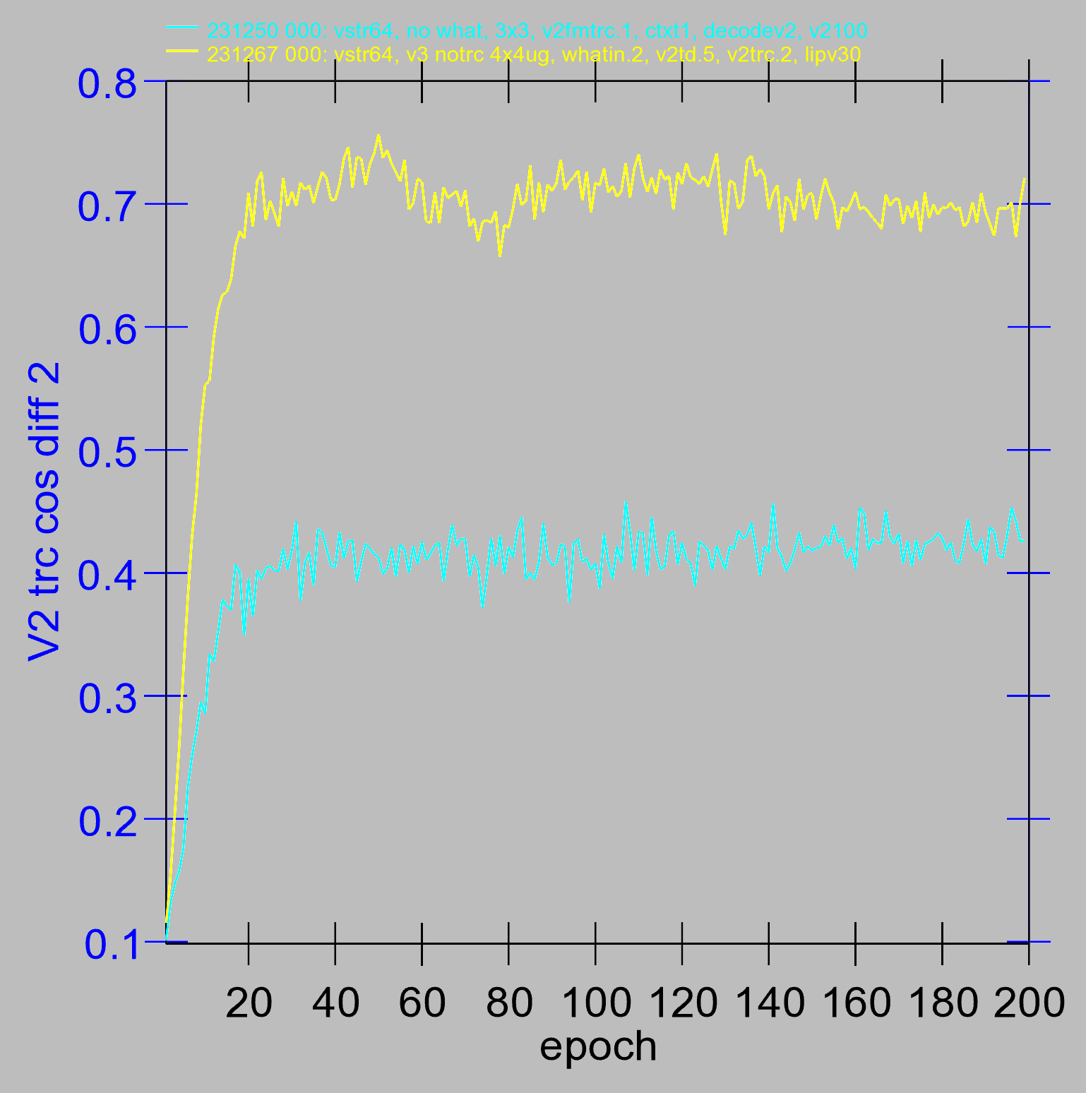
Effect of Top-down “What” reps

Slide 22
Key Results
Accurate prediction of visual world requires top-down input of high-level eye & object location and motion information
Visual angle is too large for low-level areas to compute
Short-cut connections V1 -> LIP exist!
With spatial location information in place, can learn abstract “what” pathway
Both together are essential for good prediction!

Slide 23
Other Results
Deep attentional dynamics can pick out figure object against background – motion and binocular depth cues provide figure signal.
TRC predictive auto-encoder on V2, V3 produces some learning benefits.
Multimodal Mutual Learning: Auditory and visual pathways train each-other to recognize and name objects.

Slide 24
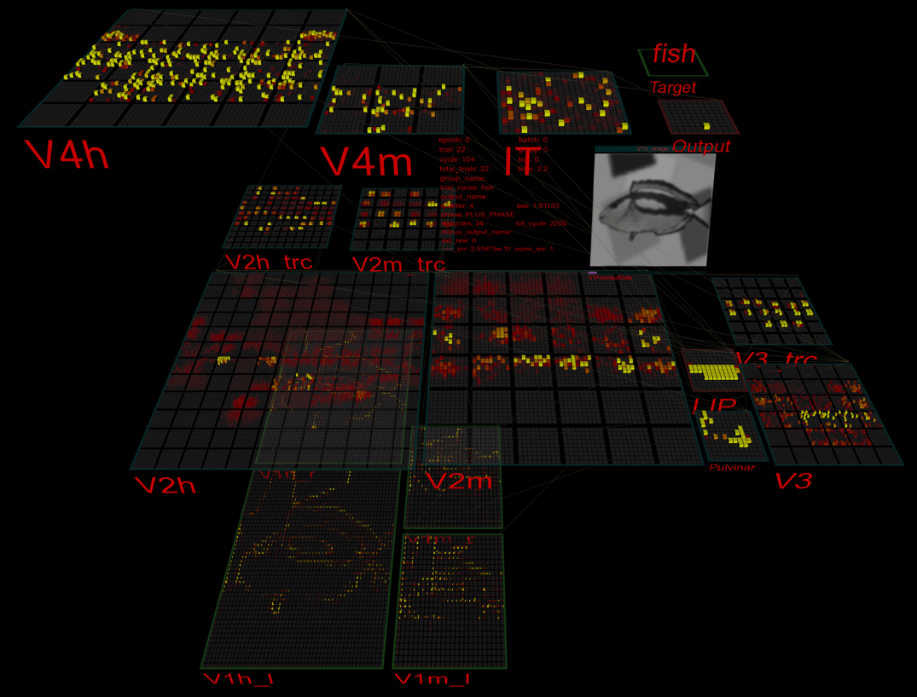
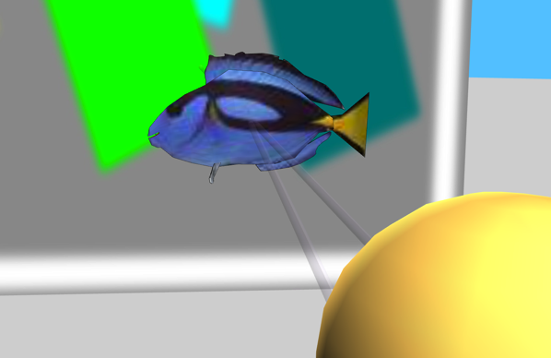
3D Virtual Reality Learning

Slide 25
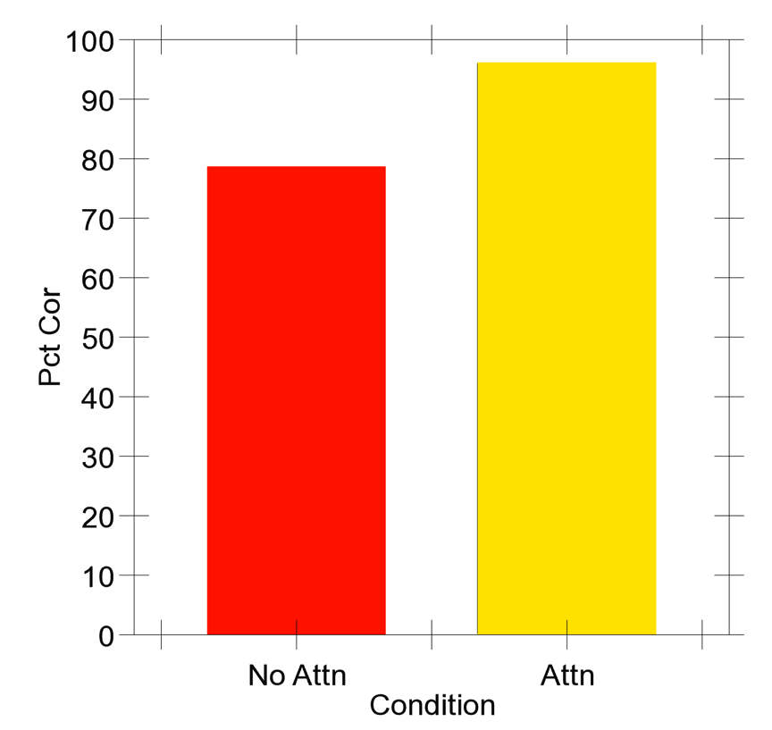
Very Preliminary Results..
50 objects against complex backgrounds..

Slide 26
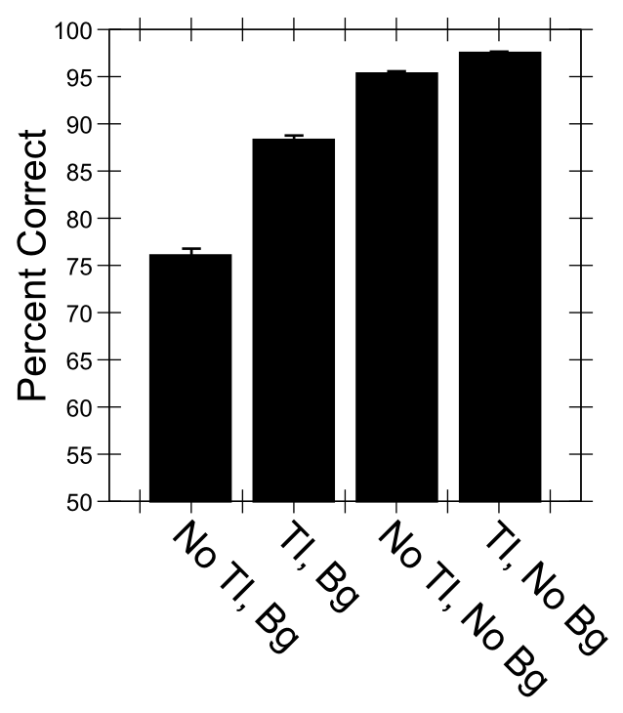
Predictive Auto-Encoding Supports Figure-Ground Segregation
Bg = backgrounds present
No Bg = Not
Differential advantage for backgrounds present case
of TI = Temporal Integration = predictive learning

Slide 27
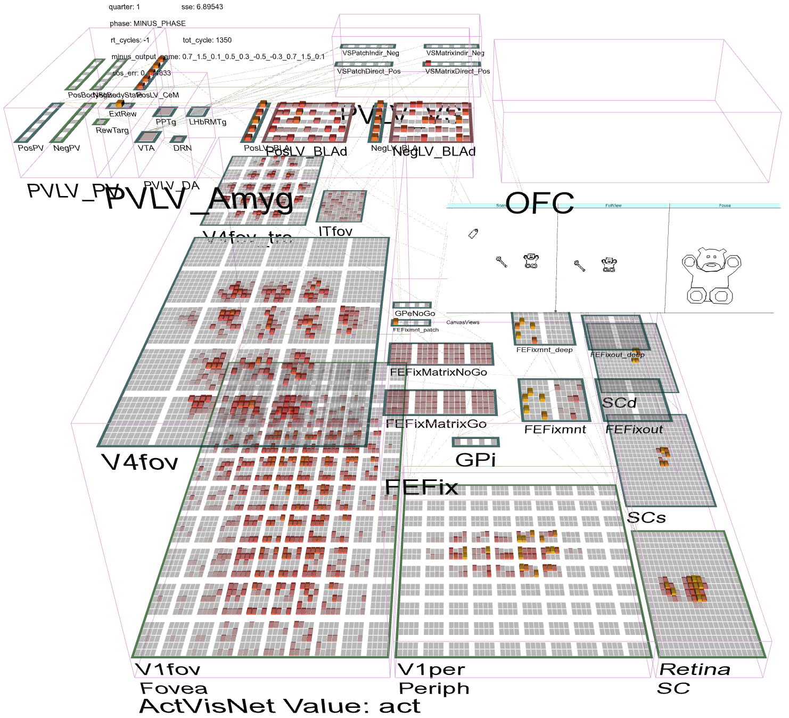
Full Brain Interactions: OFC, FEF..

Slide 28
Problems with Recurrent Connectivity
Computationally much slower than feedforward
~100 cycles per input image, ~4x connections (2x directions, superficial and deep)
Not applicable to ImageNet scale at this point
Could really use fast specialized hardware! (“if I only had a brain…”)
But algorithms are under rapid development..
Much more complex dynamics: learning problem is much more difficult

Slide 29
Summary: Two Networks in One
Recurrent dynamics / consciousness supports goal-driven top-down interaction with bottom-up:
Superficial cortical layers:
Hopfield / Boltzmann constraint satisfaction
Deep cortical layers & thalamus:
Attentional dynamics
Deep layers particularly important for top-down
Multiplicative, normalization dynamics
Predictive learning
Context from t-1 to predict at time t (SRN)
Time updates every 100 msec (10 Hz, alpha)
Thalamic relay cells (TRC) substrate for local auto-encoder learning

Slide 30
Big Picture
Higher-level cognition emerges from sensory-motor attentional dynamics
Binding multiple elements of a visual scene, understanding their relationship is foundation of many cognitive abilities: language, analogy, Raven’s task, etc..

Slide 31
Thanks To
CCN Lab
Tom Hazy
Seth Herd
Tren Huang
Dave Jilk (eCortex)
Nick Ketz
Trent Kriete
Kai Krueger
Scott Mackie
Brian Mingus
Jessica Mollick
Wolfgang Pauli
John Rohrlich
Sergio Verduzco-Flores
Dean Wyatte
Funding
ONR – Hawkins
ONR – McKenna & Bello
IARPA – ICArUS
ARL RCTA
NIMH P50-MH079485

Slide 32
Extras

Slide 33
Learning Causal Structure
LeabraTI (Temporal Integration) neural network learns by predicting what happens next
Learns de novo causal logic from multi-agent causal events unfolding over time.
Can generalize this learned structure to novel entities, based on how they behave
Fits human data in range of causal inference tasks (“blicket” paradigm): backwards blocking, screening off, conjunctive, disjunctive, noisy..

Slide 34
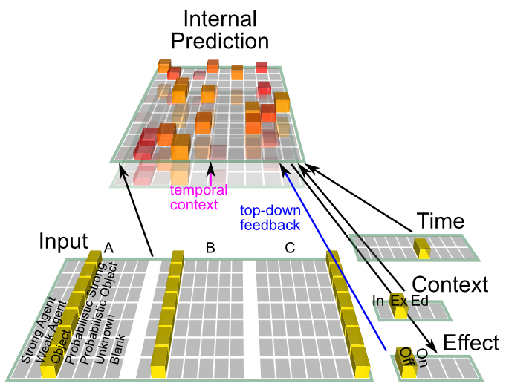
TI Model

Slide 35
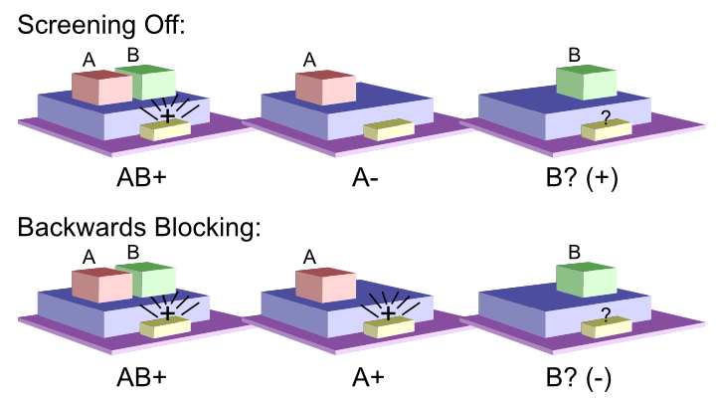
The Blicket Detector

Slide 36
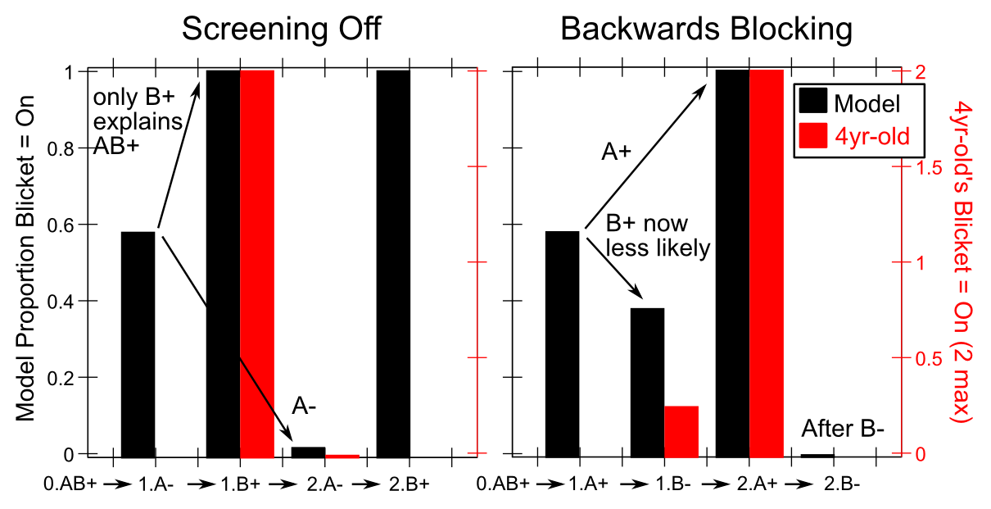
Model Results

Slide 37
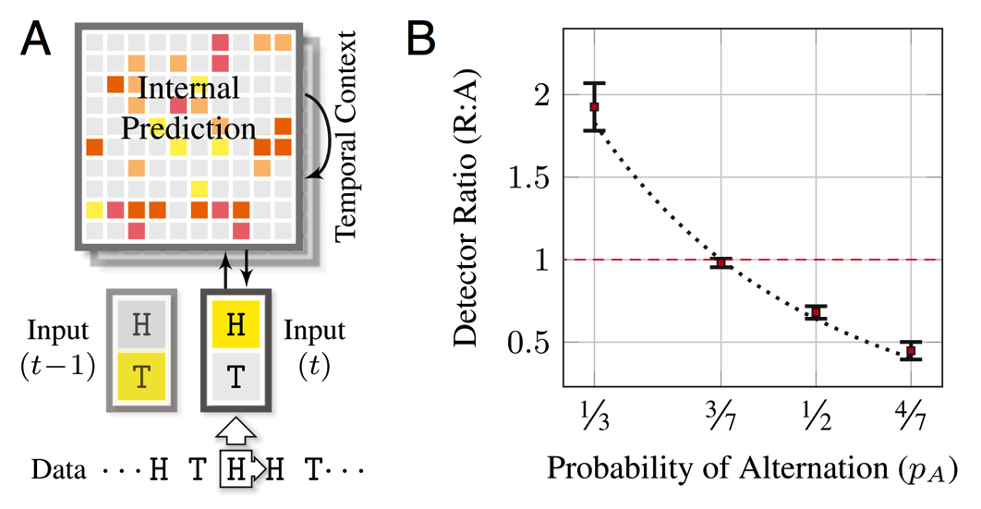
Structure in Random Sequences (Sun et al, 2015, PNAS)
LeabraTI model applied to random coin flips, develops bias in favor of alternations: origin of gambler’s fallacy? Rationally: based on differential higher-order statistics of repeating vs. alternating patterns.

Slide 38
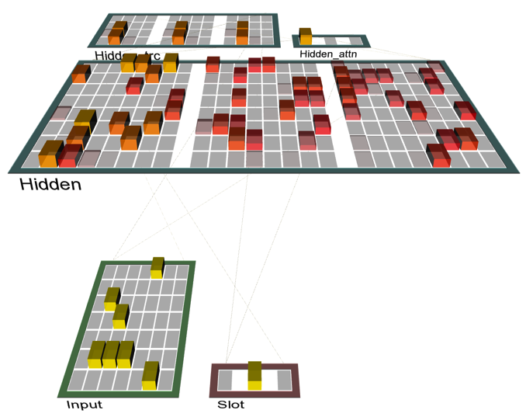
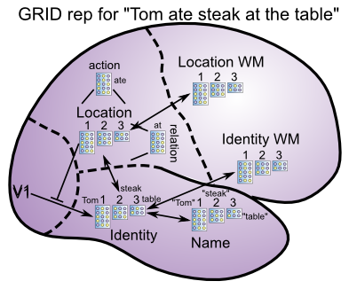
Emergent Structured Bindings
Slot-based role-filler binding emerges through DeepLeabra attentional and local auto-encoder dynamics, in basic structured information encoding and retrieval task. Learned version of Taatgen’s “generic chunk” information routing ACT-R model.

Slide 39
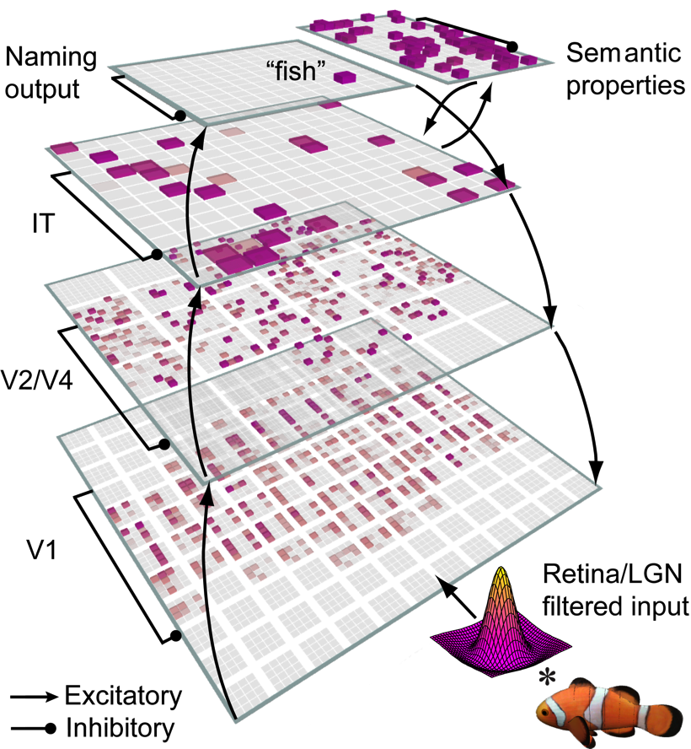
Bidirectional Object Recognition (e.g., O’Reilly et al., 2013)
100-way invariant object recognition

Slide 40
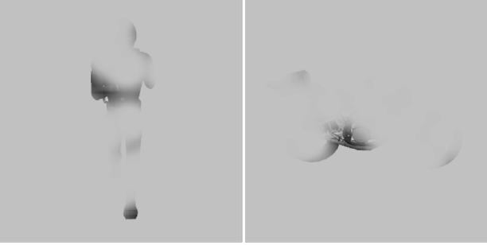

Benefit of Bidirectionality: Robust to Partial Occlusion

Slide 41
Human Data (Wyatte et al, 2012)

Slide 42
But…
Attractor nets don’t pull out individual elements from complex scenes, or rapidly shift (instead, get “stuck”)

Slide 43
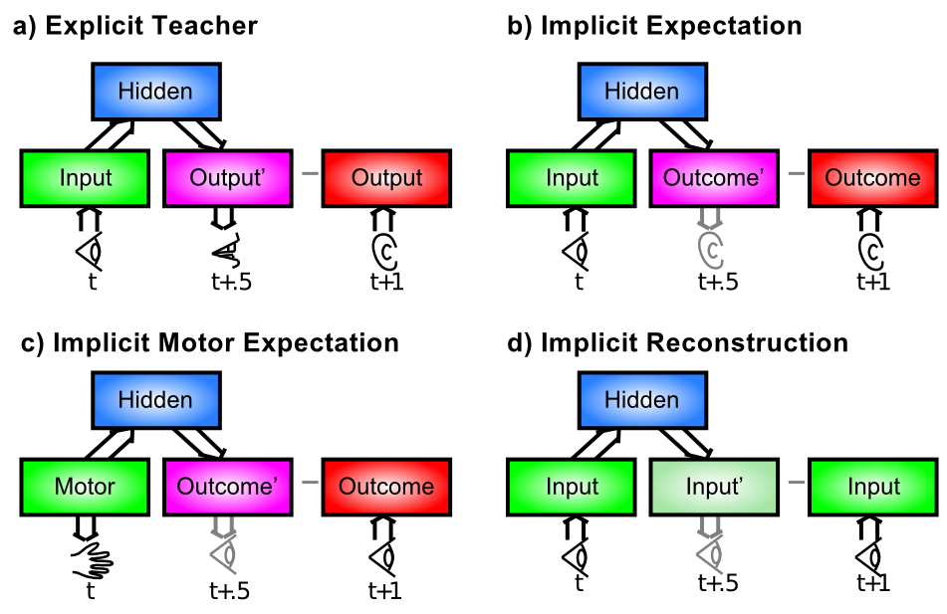
Where do the Targets Come From?

Slide 44
The Bootstrap Solution
How do the high-level “outputs” get active?
From a sensory modality (e.g., auditory input)
Infinite regress: need high-level training of that!
Solution: need to bootstrap our way up to multi-modal mutual-training systems (c.f., Becker, de Sa)
Now we just need a way for sensory modalities to train themselves… and Hebbian learning isn’t up to the task.

Slide 45
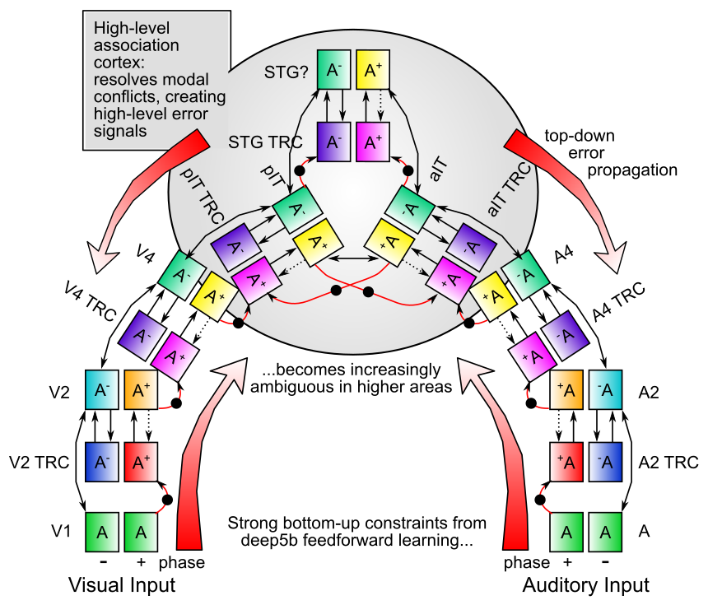

Slide 46
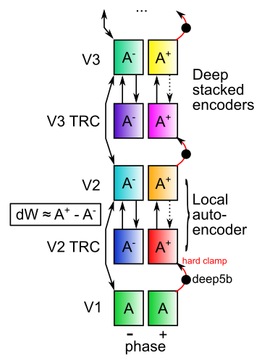
Nested Thalamic Auto-Encoders (Deep5aed: Deep5b Auto Error Driven)
Each layer learns by auto-encoding the layer below (c.f., restricted Boltzmann machines)
Plus phase target: Deep layer 5b neocortical neurons (intrinsic bursting, 10Hz alpha rhythm): drivers of thalamic relay cell (TRC) firing at next feedforward layer (Sherman & Guillery)
Minus phase: weaker but much more numerous layer 6 -> TRC

Slide 47
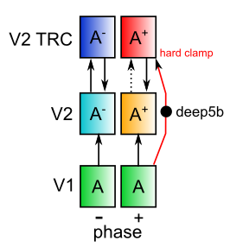
Nested Thalamic Auto-Encoders (Deep5aed: Deep5b Auto Error Driven)
Really is a standard auto-encoder!

Slide 48
Nested Thalamic Auto-Encoders (Deep5aed: Deep5b Auto Error Driven)
Advantages:
Automatic, internal – / + phases
deep5b bursting = amplification of error signals – each layer has own local error
Encoding is done on reduced, transformed version of prior layer -> greater abstraction
Full bidirectional constraint satisfaction across network contributes to minus phase
and plus phase: supports both local and distal learning

Slide 49
Nested Thalamic Auto-Encoders (Deep5aed: Deep5b Auto Error Driven)
Advantages:
Each layer is more strongly constrained – should improve generalization and overall robustness – e.g., object recognition operates on “2.5d sketch” of visual world, not just on pixels or gabor jets
Fixes “adversarial image” problem?

Slide 50
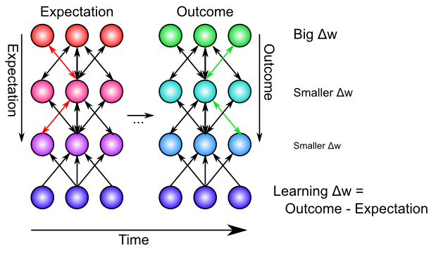
Bidirectional Connections Carry Error Gradients (GeneRec; O’Reilly, 1996)
Generalization of Recirculation (Hinton & McClelland, 1988)

Slide 51
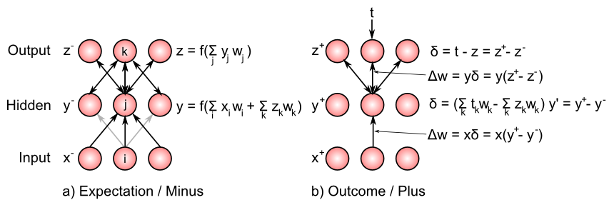
Bidirectional Connections Carry Error Gradients (GeneRec; O’Reilly, 1996)
Midpoint integration + symmetry = Contrastive Hebbian = DBM

Slide 52
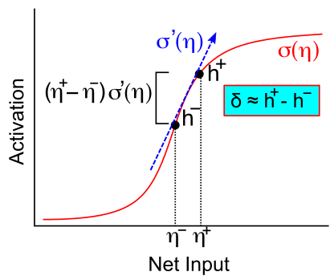
Activation Diffs Implicitly Compute Derivatives (GeneRec; O’Reilly, 1996)
Free to use arbitrarily complex activation functions!

Slide 53
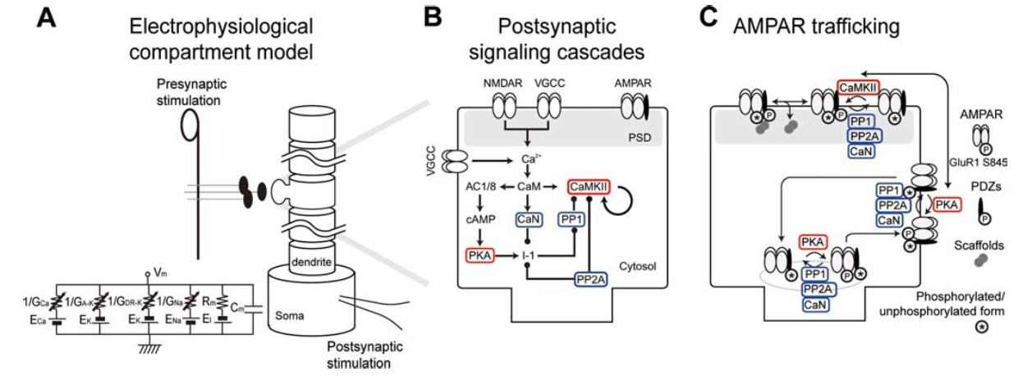
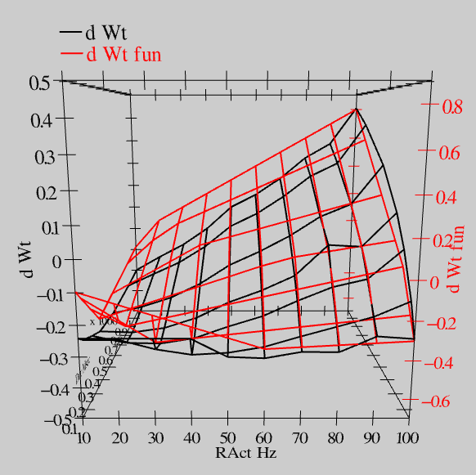
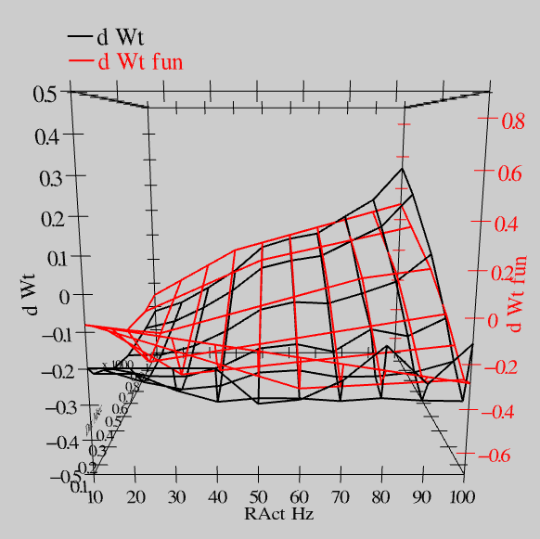
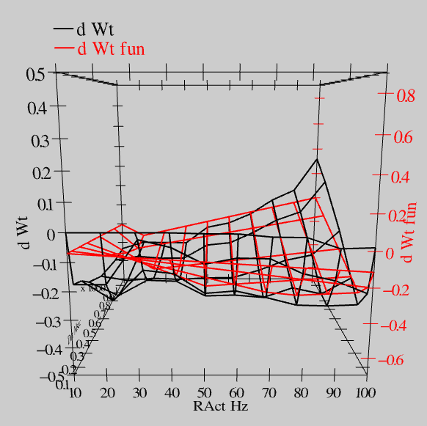
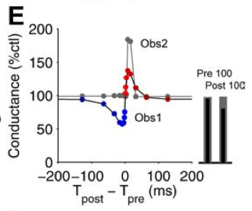
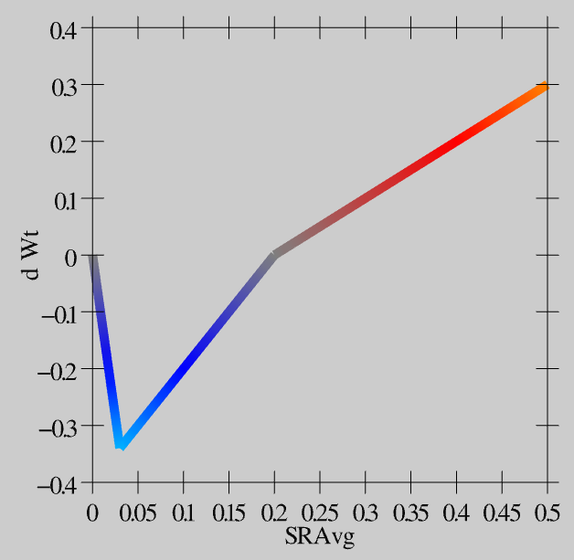
Synaptic Plasticity: XCAL Model (reduction of Urakubo et al, 2008 STDP model)
S = 100Hz
S = 50Hz
S = 20Hz
dW = f(send * recv) =
(spike rate * duration)
r=.894

Slide 54
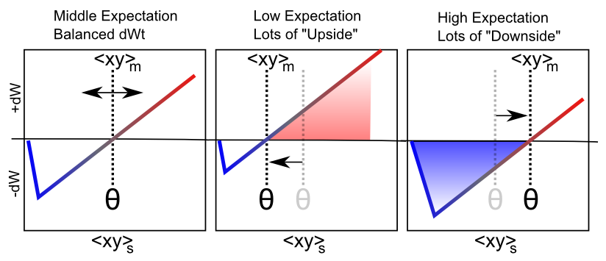
Floating Threshold = Medium Term Synaptic Activity (Error-Driven)
dW = Outcome – Expectation = <xy>_{s} - <xy>_{m}

Slide 55
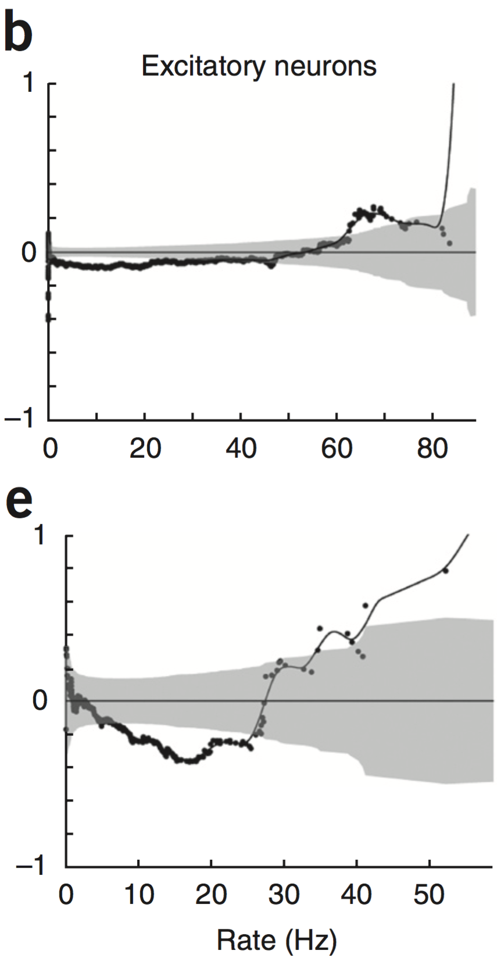
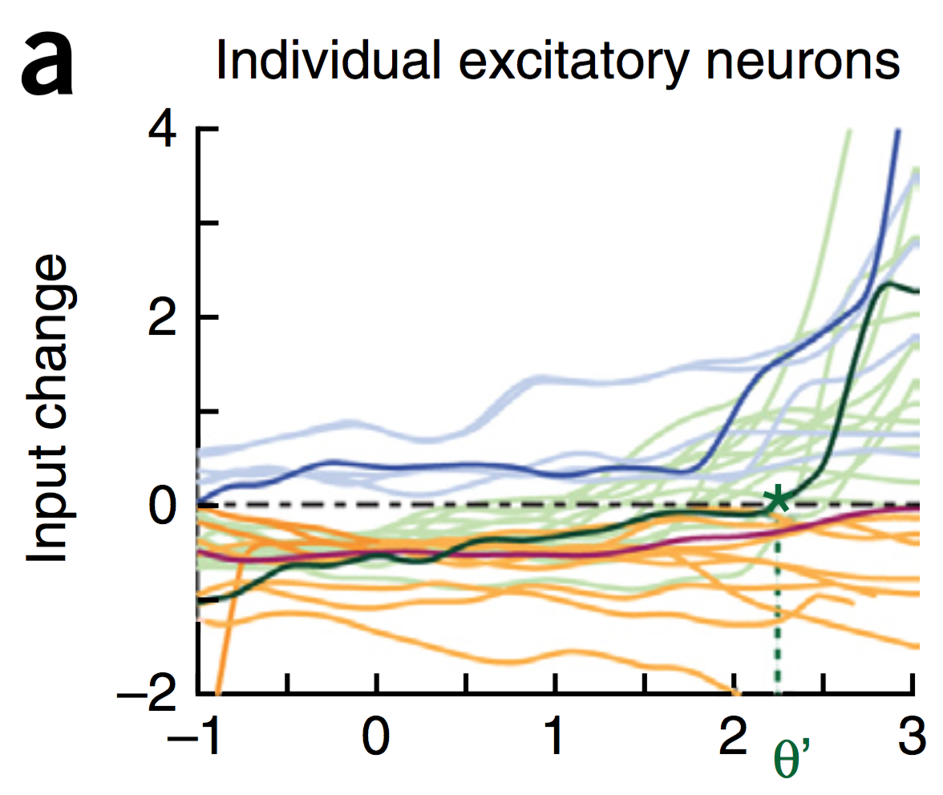
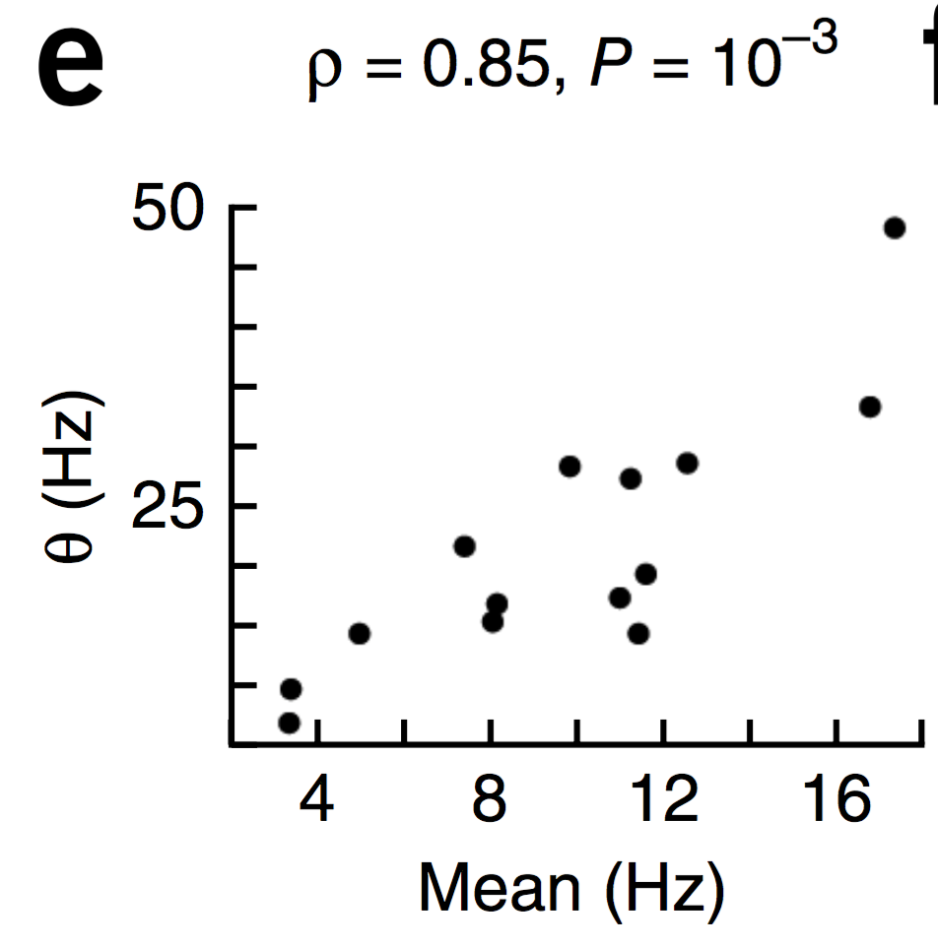
Evidence of Dynamic Thresholds (Lim, McKee, Woloszyn et al., 2015)
b = passive viewing
e = active task
Threshold changes dynamically on a rapid time scale, as a function of short-term activity level!

Slide 56
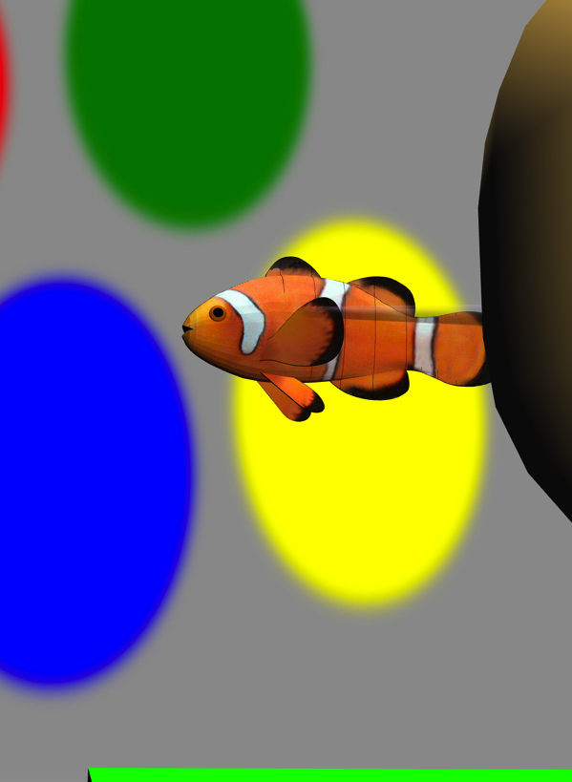
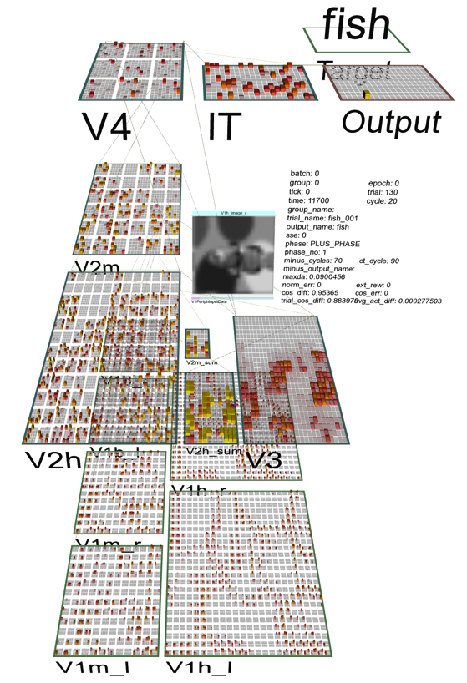
Test Application: Learning Early Visual Structure

